Slide 1

ORGANIZATION
An organization is a group of people with a defined relationship in which they work together to achieve the goals of that organization. This relationship does not come to end after completing each task.

Slide 2

BEHAVIOUR
It is a verbal or physical response shown by a person as a consequence of the impact of his/her surroundings.

Slide 3
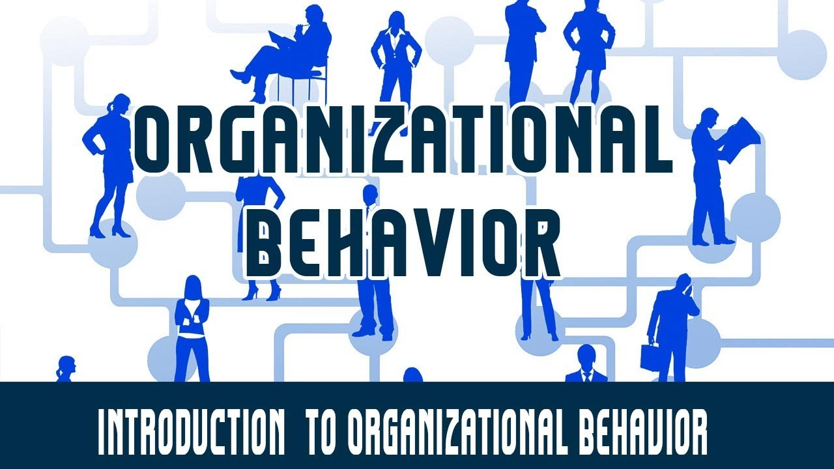

Slide 4
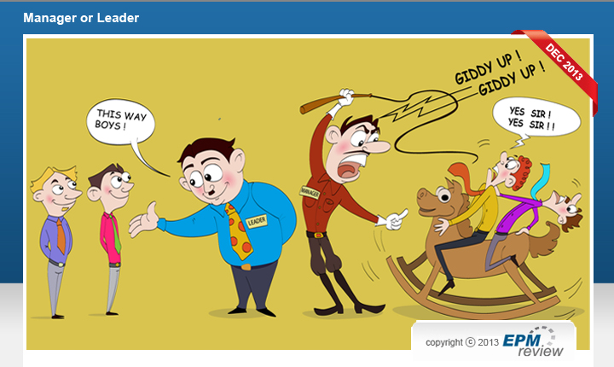
Organizational Behaviour
“Organizational behaviour is a field of study that investigates the impact that individuals, groups and organizational structure have on behaviour within the organization, for the purpose of applying such knowledge towards improving an organizational effectiveness”.
- Stephens P. Robbins

Slide 5

Need & Importance of OB
A road map to living beings in organization
To understand and predict organizational life
To know organizational events
To understand self & others
To manage HR effectively
To maintain cordial IR
To improve quality & productivity
To make effective communication
To introduce change in the organization

Slide 6
Contributing Fields to Organizational Behaviour
Psychology
Sociology
Anthropology
Social psychology
Political science

Slide 7

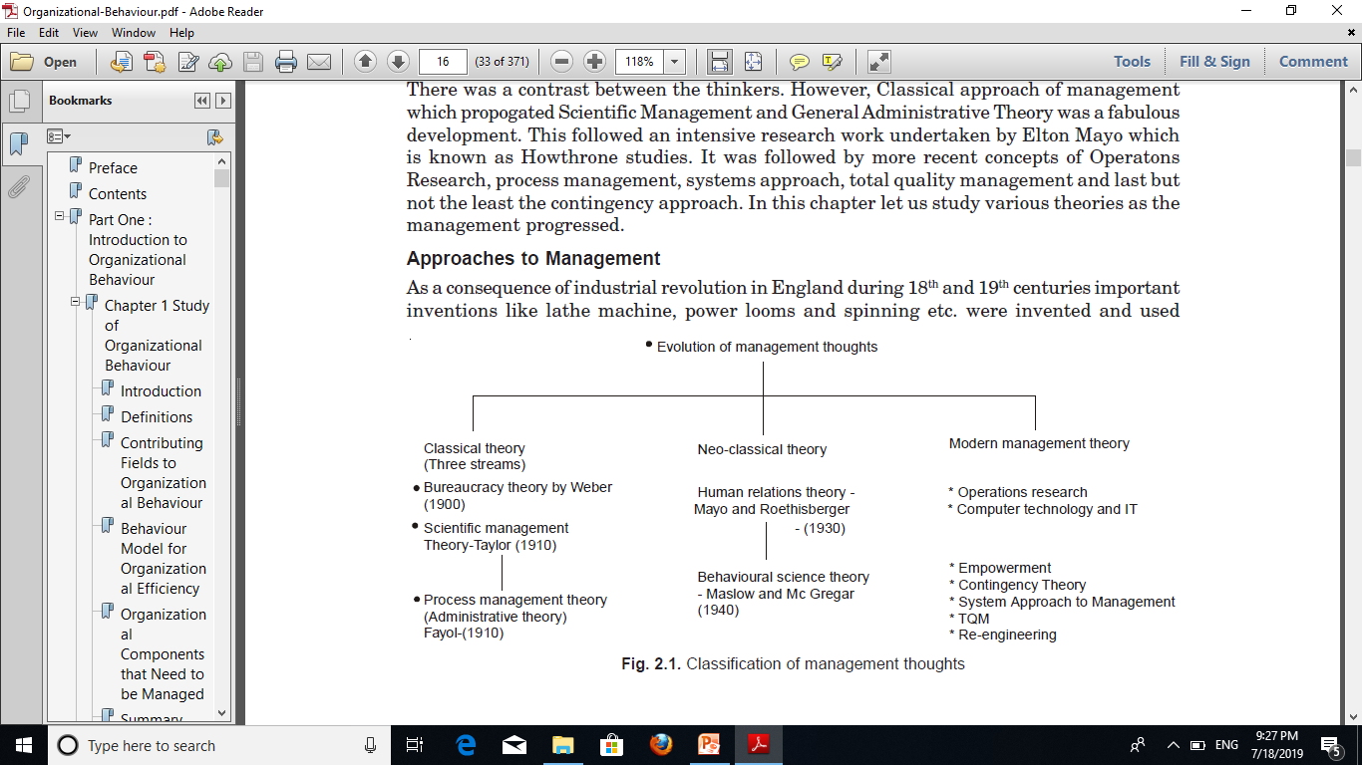
HISTORICAL EVOLUTION OF ORGANIZATIONAL BEHAVIOUR

Slide 8

CLASSICAL THEORIES OF MANAGEMENT

Slide 9

BUREAUCRACY
legal authority
Traditional authority
Charismatic authority

Slide 10

Bureaucratic Approach
Task specialization
Formal selection
Rules and requirements
Impersonal
Hierarchical layers of authority
Career orientation

Slide 11

Scientific Management Approach
The scientific management approach is based on the concept of planning of work to achieve efficiency, standardization, specialization and simplification.
Taylor (1947) proposed 4 principles of management

Slide 12
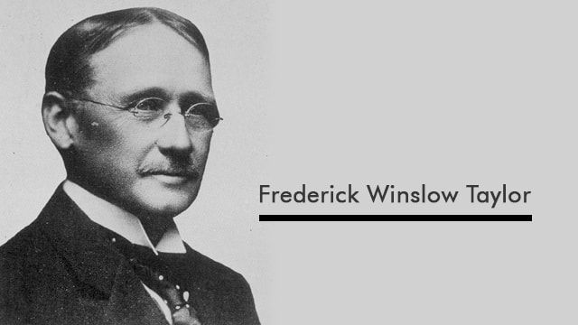

F.W.Taylor - Principles of Scientific Management
Scientific selection of workers and their development through proper training.
Scientific approach by management. The management has to develop a true science in all fields of work activity through scientific investigation and experiments.
Close co-operation of managers and workers (labour management relations) for better results and understandings.
Elimination of conflict between methods and men. The workers are likely to resist to new methods. This can be avoided by providing them an opportunity to earn more wages.

Slide 13
Principles of Scientific Management
Science, not rule-of-thumb;
Scientific selection of the worker
Management and labour cooperation rather than conflict
Scientific training of workers

Slide 14

PROCESS MANAGEMENT THEORY (Administrative Theory)
Administrative theory was propounded by Henry Fayol and is based on 14 principles of management.
In addition, management was considered as a set of planning, organizing, training, commanding and coordinating functions.

Slide 15


Henry Fayol -14 Principles of Management
Division of work
Authority and responsibility
Discipline
Unity of command
Unity of direction
Subordination of personal interest to organizational interests
Remuneration
Centralization
Scalar chain
Order
Equity
Stability of tenure
Initiative
Esprit de Corps

Slide 16
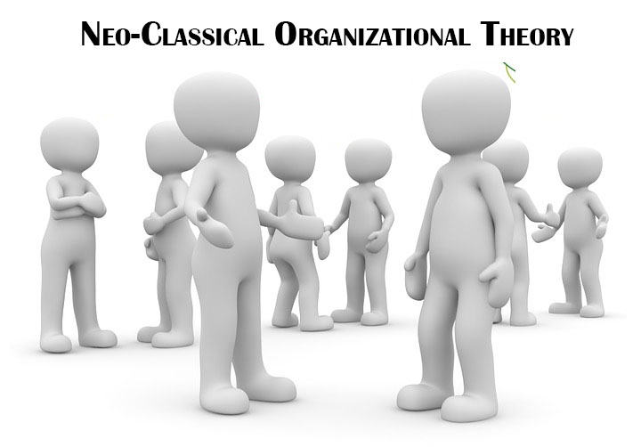
Neoclassical theory
Neoclassical theory emphasizes individual or group behaviour and human relations in determining productivity.

Slide 17

Essential Features of the Neoclassical Approach
The Business Organization is a Social System
The Human Factor is the most critical element in this Social System
Social and Psychological Factors play a Crucial Role in Determining Productivity and Employee Satisfaction
The Management Should also Develop Social And Leadership Skills apart from Technical Skills. They Should Think More about the Welfare of Workers
Productivity in an Organization is Directly Related to Employee Morale.

Slide 18
Neoclassical Approach
Human Relations Movement
Elton Mayo , Fritz J. Roethlisberger’s Hawthorne
Behavioral Movement
A.H. Maslow, Douglas McGregor, Argyris, F. Herzberg, Rensis Likert, J.G. Likert, Kurt Lewin and Keith Davis

Slide 19

Conclusions of Hawthorne Studies / Experiments
The social and psychological factors are responsible for workers' productivity and job satisfaction. Only good physical working conditions are not enough to increase productivity.
The informal relations among workers influence the workers' behaviour and performance more than the formal relations in the organisation.
Employees will perform better if they are allowed to participate in decision-making affecting their interests.
Employees will also work more efficiently, when they believe that the management is interested in their welfare.
When employees are treated with respect and dignity, their performance will improve.
Financial incentives alone cannot increase the performance. Social and Psychological needs must also be satisfied in order to increase productivity.
Good communication between the superiors and subordinates can improve the relations and the productivity of the subordinates.
Special attention and freedom to express their views will improve the performance of the workers.

Slide 20

Principles of The Neoclassical Approach
INDIVIDUAL
WORK GROUP
PARTICIPATIVE MANAGEMENT

Slide 21
HISTORICAL EVOLUTION OF ORGANIZATIONAL BEHAVIOUR

Slide 22
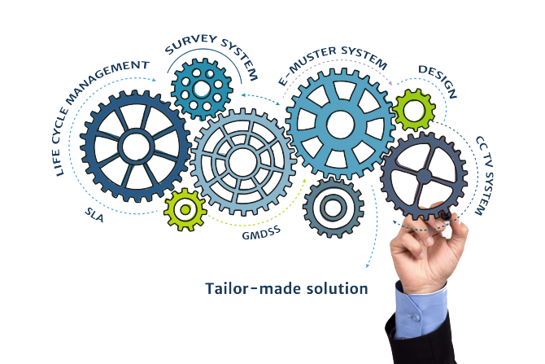
Systems Approach
The systems approach considers the organization as a system composed of a set of inter-related - and thus mutually dependent - sub-systems. Thus the organization consists of components, linking processes and goals .

Slide 23
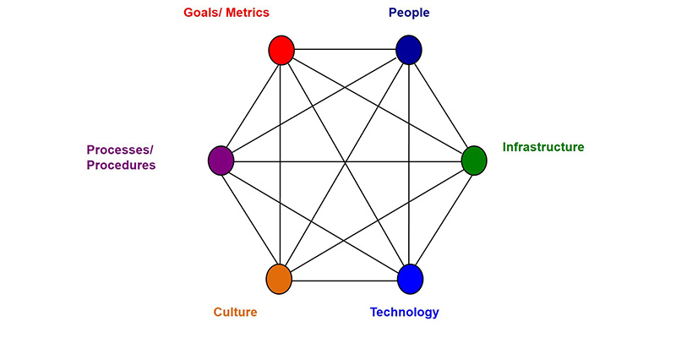
Socio-technical Approach
The socio-technical approach considers the organization as composed of a social system, technical system and its environment. These interact among themselves and it is necessary to balance them appropriately for effective functioning of the organization.

Slide 24

Contingency or Situational Approach
The contingency or situational approach recognizes that organizational systems are inter-related with their environment and that different environments require different organizational relationships for effective working of the organization.

Slide 25

Assumptions of the Contingency Approach
There is no one best type of organisation which suits all enterprises.
Even in the same organisation different approaches may be necessary to deal with different situations.
A large number of variables, including goals, attitudes and sense of values of people, technology and conditions of the market determine the structure, process and over­all approach of an organisation.

Slide 26

Cont,..
Management has to develop the requisite diagnostic skill so that they can hit upon the right type of policy at the right time and in the right situation.
Adaptability to change, particularly to environmental change constitutes one of the biggest challenges to modern organisations. The organisation should be so designed that it is flexible enough to change with the environment.

Slide 27
Approaches to Management
Scientific Management Approach
Human Resources Approach
Productivity Approach
Contingency Approach
System Approach
Bureaucratic Approach
Interdisciplinary Approach

Slide 28

Interdisciplinary Approach
Organizational behaviour is basically an interdisciplinary approach. It draws heavily from other disciplines like psychology, sociology and anthropology
Organizational behaviour integrates the relevant contents of these disciplines to make them applicable for organizational analysis

Slide 29

Challenges and Opportunities of Organizational Behavior
Improving Peoples’ Skills
Improving Quality and Productivity
Total Quality Management (TQM)
Managing Workforce Diversity
Responding to Globalization
Empowering People
Coping with Temporariness
Stimulating Innovation and Change
Emergence of E-Organisation & E-Commerce
Improving Ethical Behavior
Improving Customer Service
Helping Employees Balance Work-Life Conflicts
Flattening World.

Slide 30

Limitations of OB
Understand human behaviour only in the workplace not in personal life
Pressure and are stressful due to constant observations
Dual personality of managers are often confusing
Organisational behaviour is selfish and exploitative
not totally remove conflict fluctuation it can only reduce them .
It will not solve the problem of unemployment .

